Slide 1

ROCKBUSTER STEALTH ANALYSIS PROJECT
ROCKBUSTER STEALTH LLC
A MOVIE RENTAL COMPANY
Presenter: Zachary Chitwood
20 August 2023

Slide 2
INTRODUCTION
Rockbuster Stealth LLC is a movie rental company that had stores all around the globe.
The management team is planning to use its existing movie licenses to launch a digital video rental service in order to stay competitive.

Slide 3
PROJECT GOALS AND MAIN QUESTIONS
What genres are most rented?
What countries have the most rentals?
Top customers are located in which countries?
What films have the most revenue gain?

Slide 4
OVERVIEW
1000 FILMS | FILM LENGTH | RENTAL DURATION | RENTAL RATE | REPLACEMENT COST
MAXIMUM | 185 MINUTES | 7 | $4.99 | $29.99
MINIMUM | 46 MINUTES | 5 | $0.99 | $9.99
AVERAGE | 115.2 MINUTES | 3 | $2.98 | $19.98
599 CUSTOMERS 600 CITIES 109 COUNTRIES
16044 rentals in total across 1000 films in six different languages.
Data has been collected between May 2005 to February 2006

Slide 5
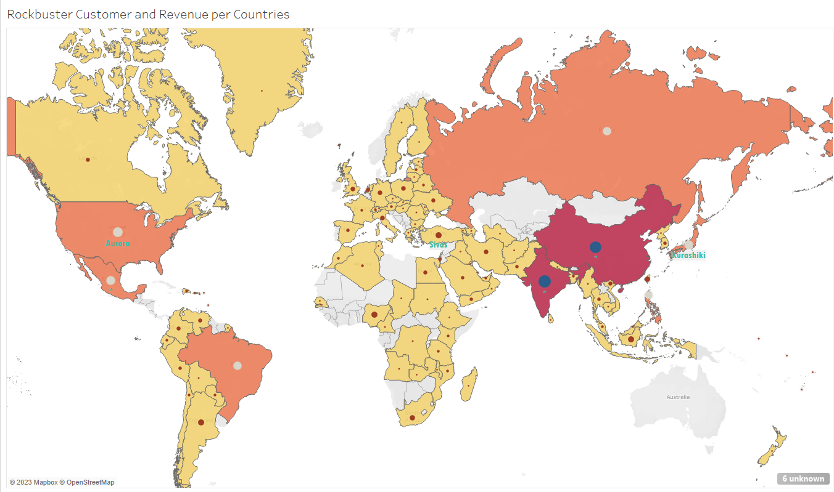
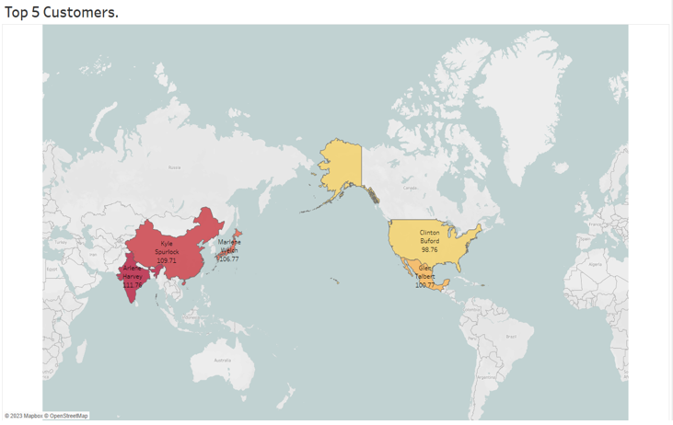
VISUALIZATIONS
Top 10 countries
India
China
USA
Japan
Mexico
Brazil
Russia
Phillipines
Turkey
Indonesia
Top five customers
Arlene Harvey- India
Kyle Spurlock- China
Marlene Welch- Japan
Glen Talbert- Mexico
Clinton Buford- USA

Slide 6
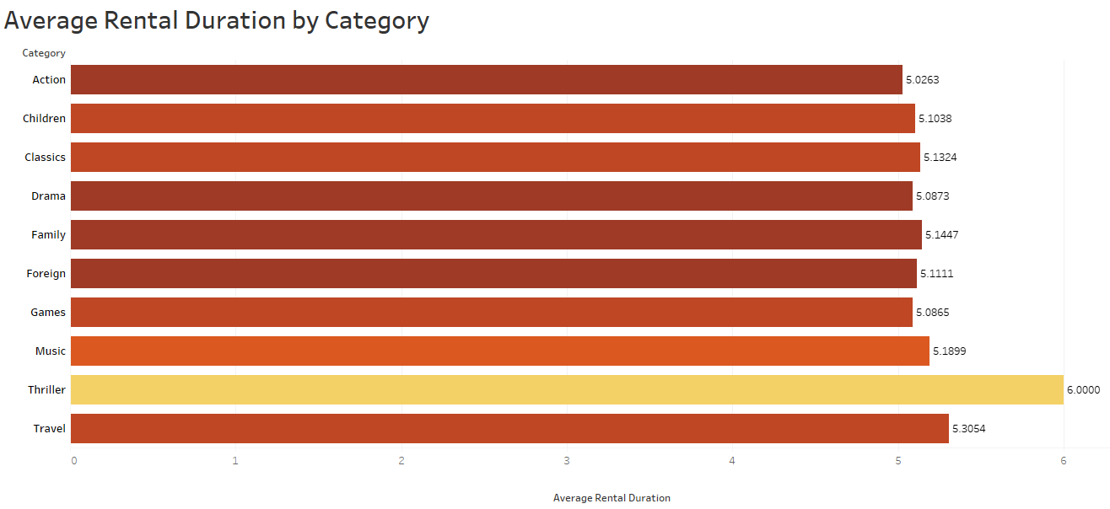
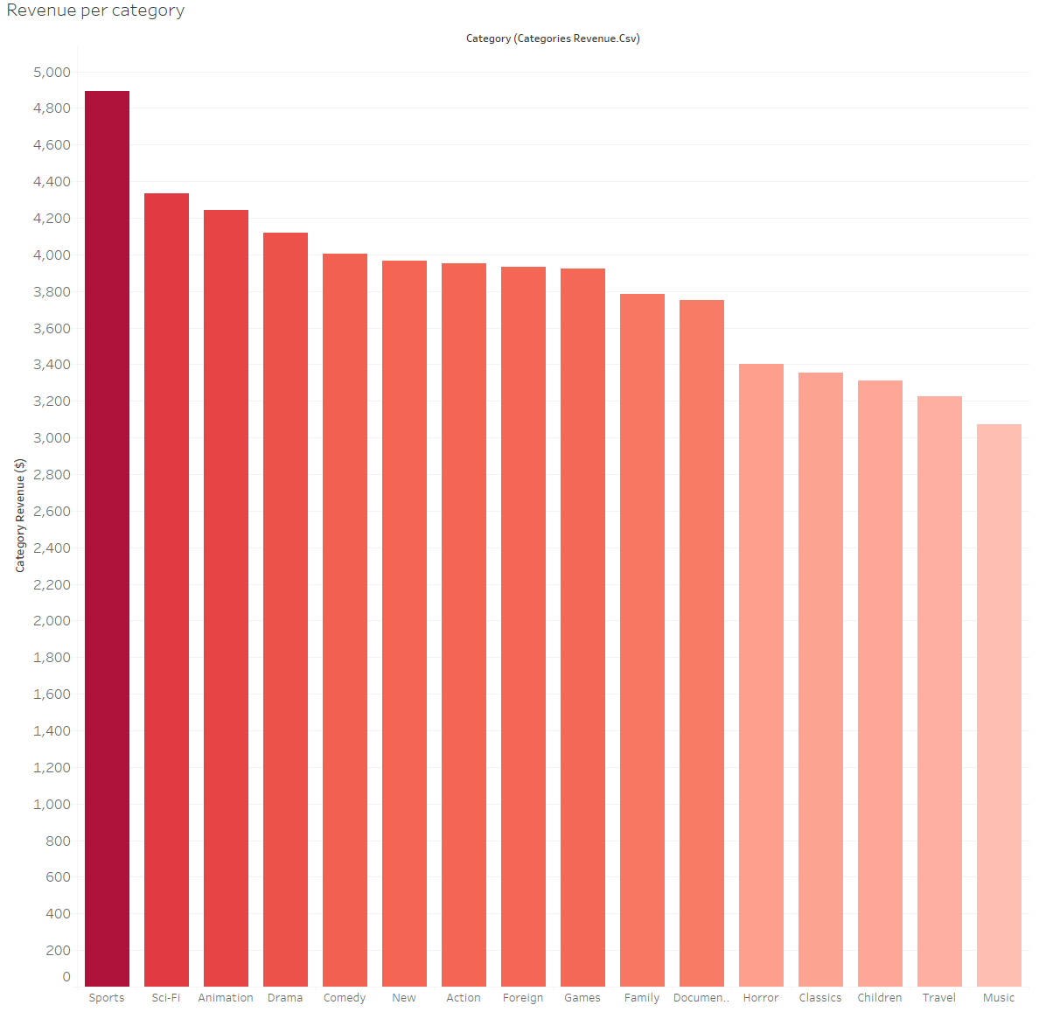
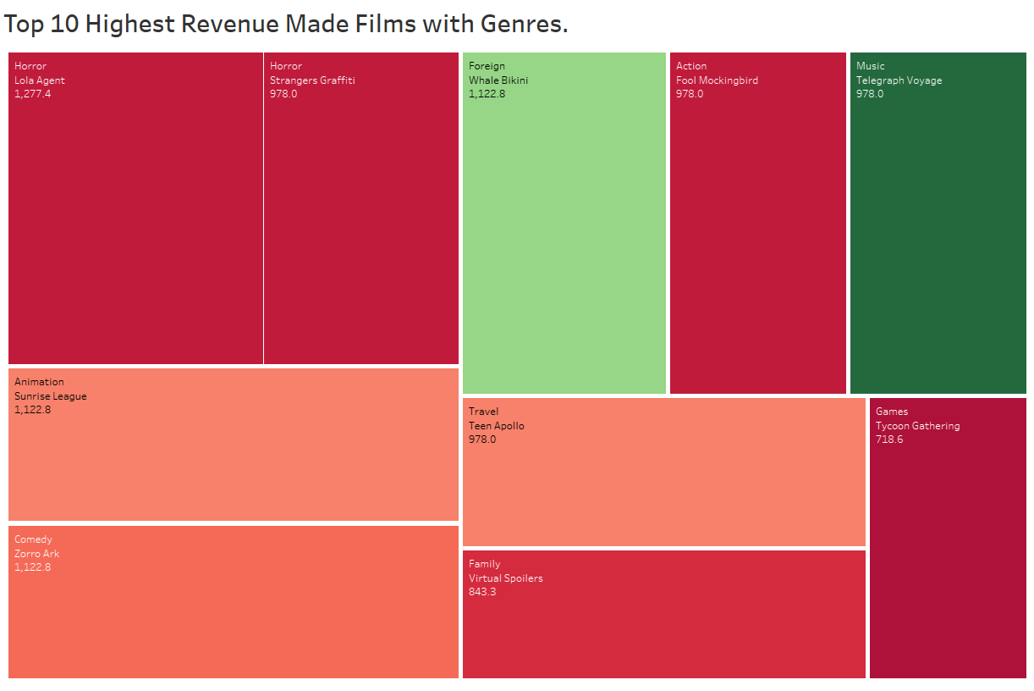
VISUALIZATIONS
This shows average rental duration by category. Showing that Thriller is the longest rented category.
Sports (8%) have the highest revenue with $4892.
Between $4336 - $3750 each, we have Sci-Fi, Animation, Drama, Comedy, New, Action, Foreign, Games, Family, and Documentary, which result in 65% of revenue.
Below $3401 each, we find Horror, Classics, Children, Travel and Music, representing 27% of the revenue.
Top ten most watched films. Lola Agent has the
highest revenue across all films.

Slide 7
Summary & Recommendations
User-friendliness and collection
Develop a friendly and easy-to-use interface for all ages that make the website appealing while having a multifarious variety of films.
Personal recommendations
Have an algorithm that suggests films based on history and what that specific user would like.
Transparency
Clearly show prices for every plan with everything included as to not have hidden items from customers.
Customer support
A lot of people base companies on how engaging their customer support is.
Innovation
Never stop improving to stay with trends while being competitive and innovative.
Reward System
Invest in a loyalty program for customers so they feel rewarded.
Establish Quality Assurance checks
Establish quarterly reviews to assess effectiveness and adjust ideas based on new data.

Slide 8
Conclusion
Average rental rate is $2.98, with a minimum of $0.99 and a maximum of $4.99
Average rental duration is 4.985 with minimum of 3 and a maximum of 7
China and India represent 18% ($5200) of the total revenue while all other countries fall below $3000 each.
Horror, Classics, Children, Travel, and Music are the least popular.
With these insights and strategies, ROCKBUSTER STEALTH LLC is poised for growth and success in the coming years.

